Slide 1
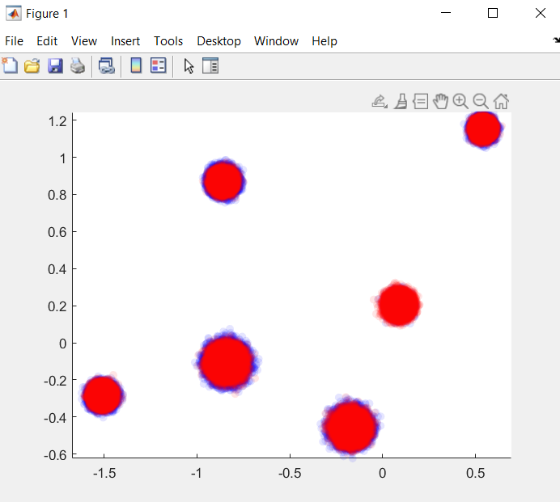
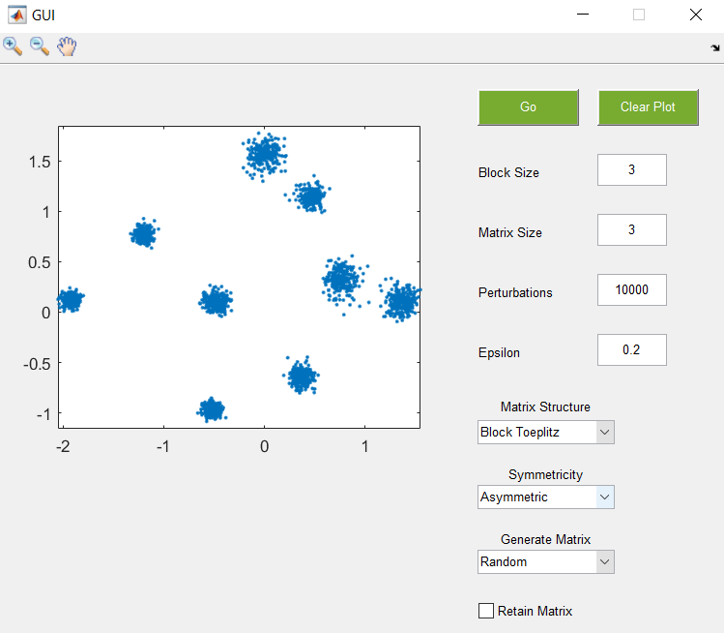
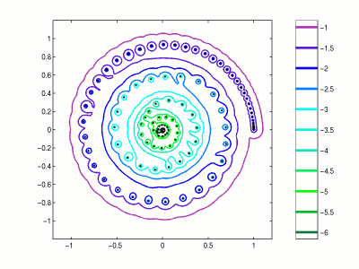
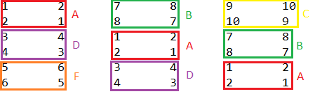
Pseudospectra and their applications
Author’s name: Viktor Tsekov
Supervisor’s name: Jani Virtanen, Raffael Hagger
Introduction
The project aims to apply techniques for numerical analysis to matrices in order to study their pseudospectra. The main matrices we are interested in are those of block Toeplitz structure. A Toeplitz matrix is a matrix in which each descending diagonal from left to right contains the same constant value. A block Toeplitz matrix is consisted of other matrices as its ‘blocks’ which also remain the same in each descending diagonal. It is important to note that when a block Toeplitz matrix is converted to a matrix with only scalars it might no longer be of the same structure. Not every block Toeplitz matrix is also a Toeplitz matrix. We aim to provide evidence for some properties that those block Toeplitz matrices are speculated to have using mathematical software such as MATLAB.
Results
The main resource we used for the project is the book of Lloyd Trefethen ‘The behaviour of non normal matrices and operators’. The book explains in few short chapters the spectra and pseudospectra of non normal matrices and their properties. The software we used for numerical analysis is called ‘seigtool’ developed by Thomas G. Wright from the University of Oxford. The software was pretty outdated so we needed to update its syntax so it can be useful again. We managed to expand upon it by adding new functionality to study the pseudospectra of block matrices. For now the software only supports block Toeplitz matrices and block Hankel matrices.
By implementing those features we managed to give evidence for one statement that says the structured and unstructured pseudospectra are similar for block Toeplitz matrices.
Comparison between structured and unstructured pseudospectra
The GUI of the produced software
In picture (1), the structured pseudospectra is marked with blue while the unstructured pseudospectra is marked with red. As we can see for all 6 eigenvalues of the matrix the perturbations stay within the same region which gives us evidence about the statement mentioned before. The difference between structured and unstructured pseudospectra is that the perturbations of the structured pseudospectra belong to a specific structure while in the other case they do not.
The software is uploaded to GitHub and can be downloaded from here:
https://github.com/ViktorTsekov/Seig_Tool
Aims and Objectives
Each nXn matrix has n number of eigenvalues. Eigenvalue is each number that when multiplied with the identity of the matrix has zero determinant. Generally when getting the pseudospectra of a matrix we perturb by n number of perturbation matrices. A perturbation matrix is a matrix that is slightly different than the original matrix. A pseudospectra is a set containing numbers that are almost eigenvalues. Having a pseudospectra we can determine the approximate range of the eigenvalues which has a huge application in physics and modern engineering.
Now when we have given definition for the terms that will be used throughout this presentation we can discuss what the project is about. Using pseudospectra we aim to explain what are the applications of pseudospectra in modern science and also give evidence for some properties of block Toeplitz matrices.
(1) Example for pseudospectra of a matrix
(2) Example for block Toeplitz matrix
Difficulties and Future Improvements
One thing we wanted to explore is under what conditions the structured and unstructured pseudospectra of a matrix are the same. One way to provide this information is by calculating distance to singularity. One theorem says that when the structured and unstructured distances to singularity are the same the pseudospectra are also the same. If we can calculate how close a matrix is to singularity we can determine under what conditions the pseudospectra is the same. But here comes the problem. In order to get distance to singularity some pretty heavy calculations are required, that a computer is incapable of doing. Plus the information returned at the end is not always completely accurate. That’s one of the biggest difficulties we faced throughout this project.
A possible improvement for the future might be the optimization of the algorithm that explores block matrices. Even though MATLAB is very well optimized the algorithm executes a little bit slowly especially when bigger matrices are involved. Another improvement might be the addition of new structures.

